Slide 1
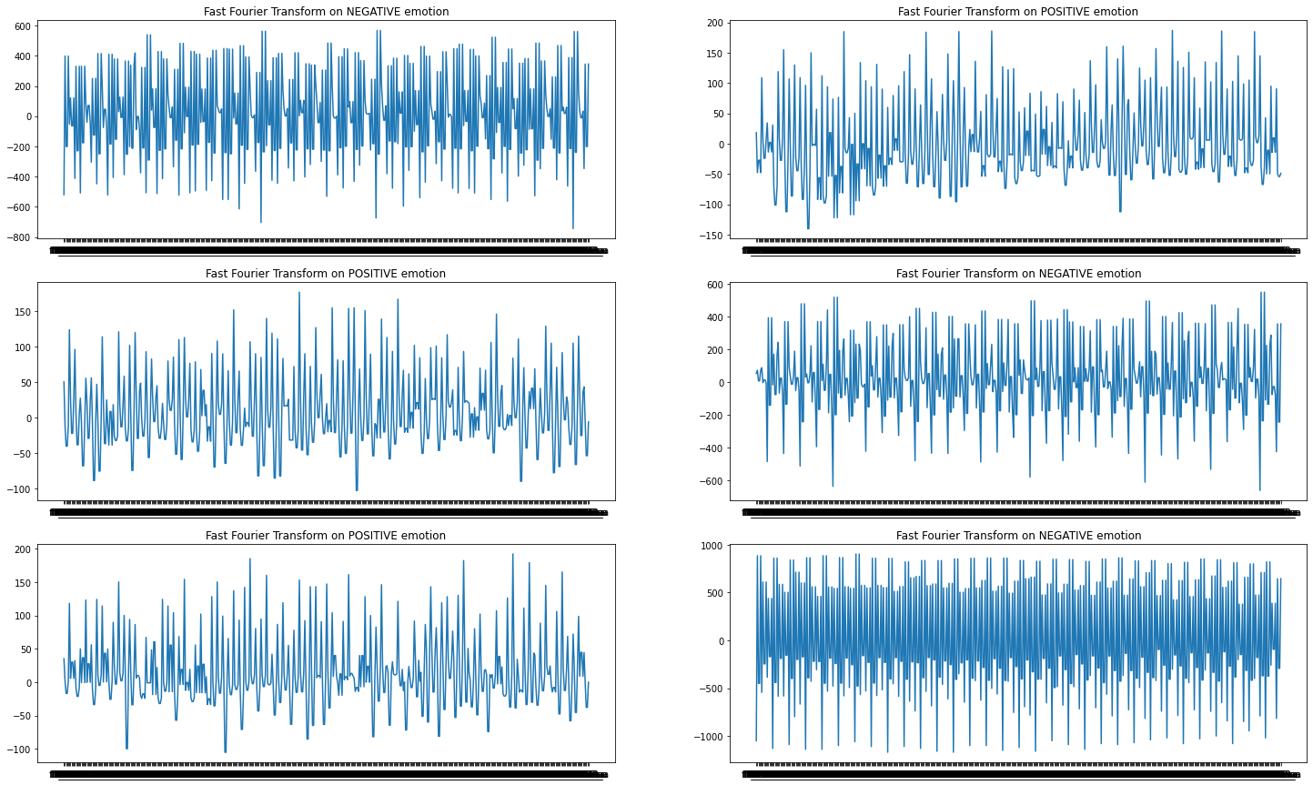
EEG Feeling Emotions
EEG Feeling Emotions – Classification with Logistic Regression.
Tell me, how are you feeling today? Oh wait, let me PREDICT it.
States your moods based on your brain electrical signals.

